Slide 1

Stemming the Tide: A Data-Driven Approach to Employee Attrition
This presentation outlines a Power BI project focused on understanding and mitigating employee attrition within our organization, leveraging data for strategic growth.

Slide 2



Understanding Attrition: Why It Matters
Cost Implications
Productivity Loss
Morale & Culture
High attrition leads to significant recruitment, onboarding, and training expenses, impacting profitability.
Loss of experienced talent disrupts operations, reduces institutional knowledge, and hinders project continuity.
Frequent departures can negatively affect remaining employees' morale and overall company culture.

Slide 3
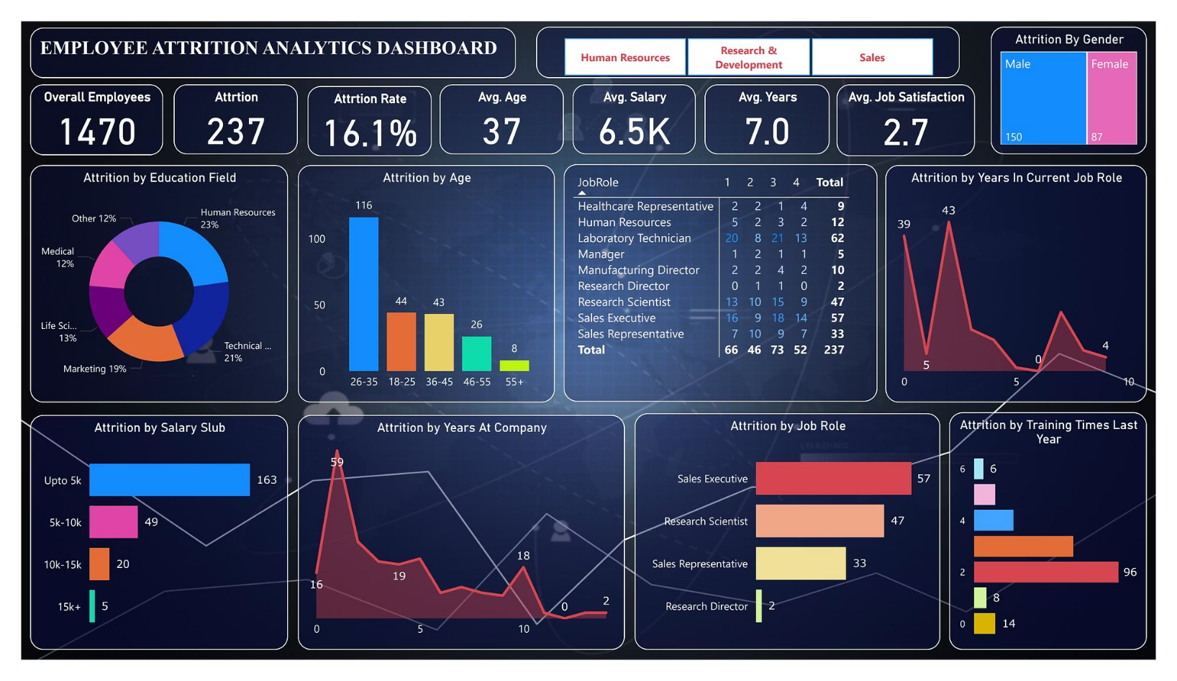
Power BI: Our Analytical Lens
Our Power BI dashboard integrates diverse HR data points, from tenure and performance to compensation and departmental demographics. This comprehensive view allows for detailed analysis of attrition trends.
The interactive nature of Power BI enables drill-down capabilities, revealing underlying factors contributing to employee departures and highlighting critical areas for intervention.

Slide 4



Key Findings from the Data
24%
18%
12%
Employees with less than 2 years tenure.
Attrition rate in the Sales Department.
Of employees citing lack of growth as a reason for leaving.
Our analysis reveals specific patterns in attrition across tenure, departments, and expressed reasons for departure.

Slide 5
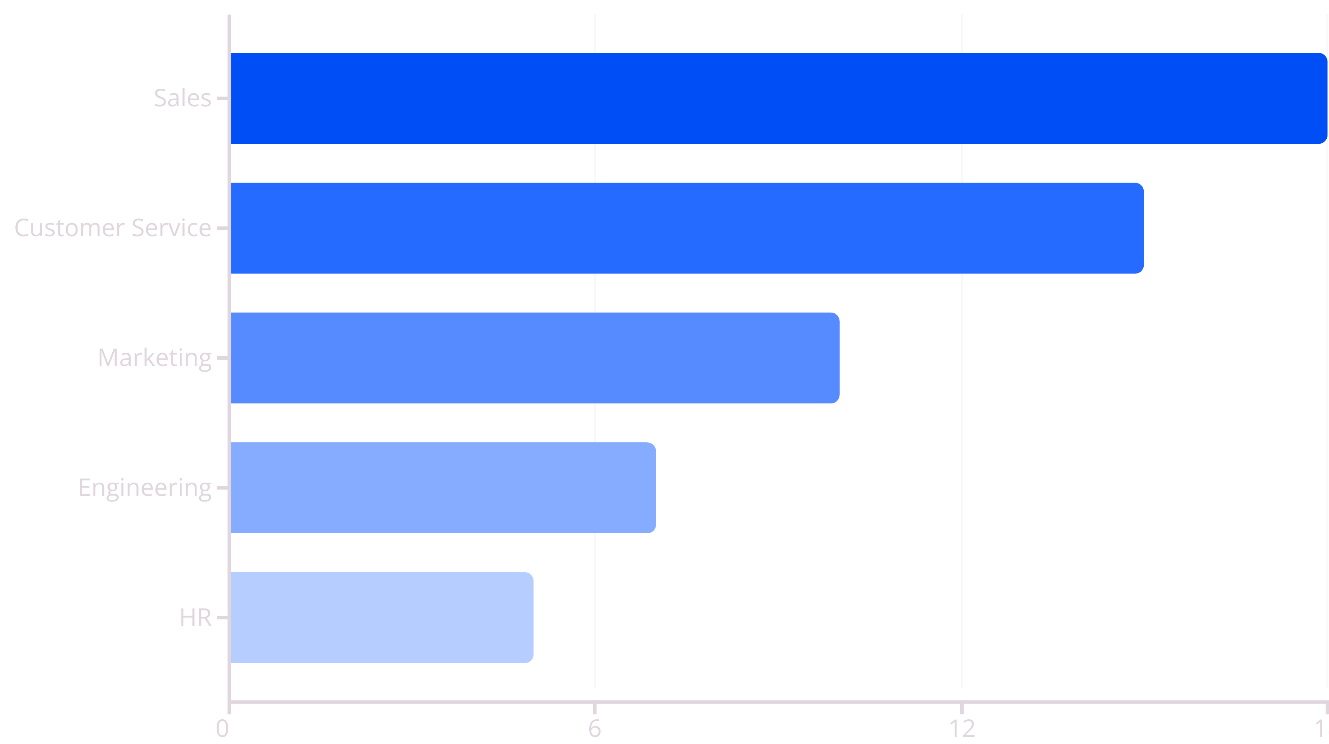
Identifying Attrition Hotspots
This chart visualizes attrition rates by department, clearly indicating areas requiring immediate attention and targeted retention strategies.

Slide 6
Strategic Interventions & Recommendations
Enhanced Career Paths
Targeted Compensation Review
Improved Management Training
Develop clear progression frameworks and mentorship programs to foster internal growth and reduce departures due to limited opportunities.
Conduct competitive salary benchmarking for high-attrition roles to ensure our offerings remain attractive in the market.
Invest in leadership development focused on effective communication, feedback, and employee engagement strategies.

Slide 7

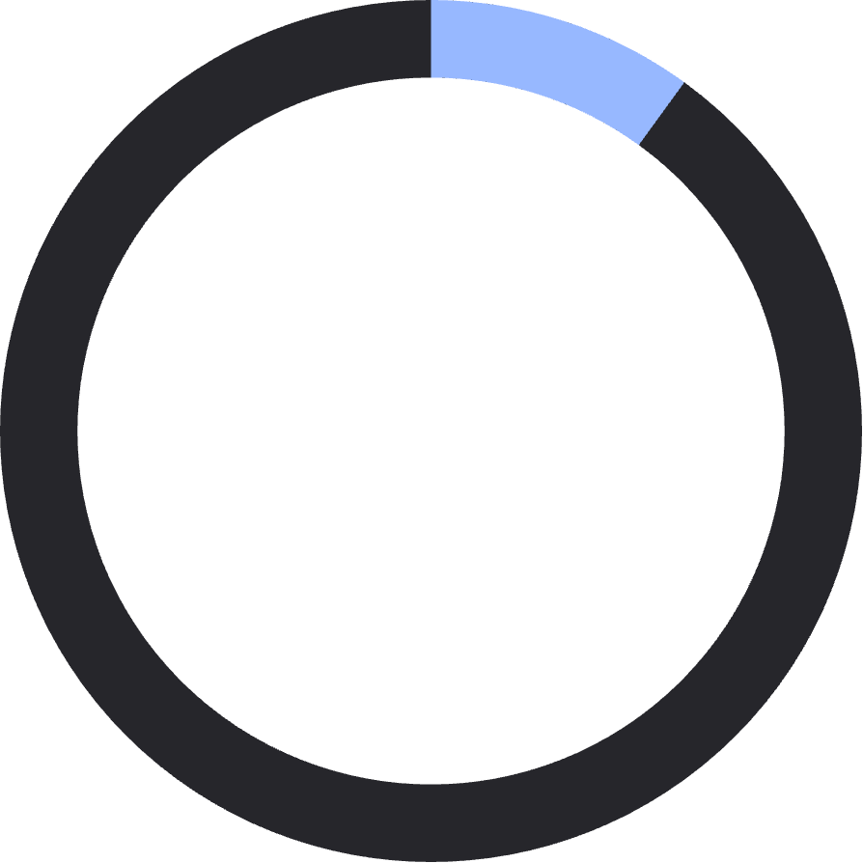

Measuring Success: KPIs & Future Monitoring
Our success in reducing attrition will be continuously monitored through key performance indicators (KPIs) tracked in Power BI.
5%
10%
80%
Reduction in overall attrition rate within 12 months.
Increase in average employee tenure.
Internal promotion rate as a percentage of open positions.

Slide 8
Next Steps & Call to Action
Review and approve proposed retention strategies.
Allocate resources for implementation of pilot programs in high-attrition departments.
Establish quarterly review meetings using the Power BI dashboard to track progress and adjust strategies.
Engage department heads for specific feedback and localized retention initiatives.
By acting decisively, we can transform attrition challenges into opportunities for growth and a stronger workforce.

